Slide 1
Application Layer Functionality and Protocols
Network Fundamentals – Chapter 3

Slide 2
Objectives
Define the application layer as the source and destination of data for communication across networks.
Explain the role of protocols in supporting communication between server and client processes.
Describe the features, operation, and use of well-known TCP/IP application layer services (HTTP, DNS, SMTP).

Slide 3
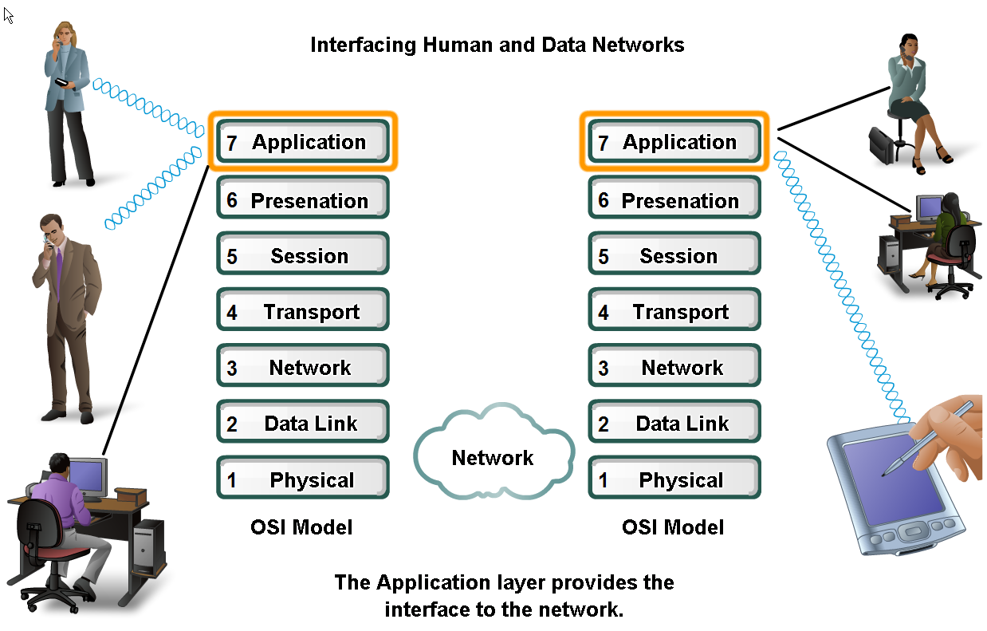
Applications –
The Interface Between Human and Data Networks
Explain that applications provide the means for generating and receiving data that can be transported on the network

Slide 4
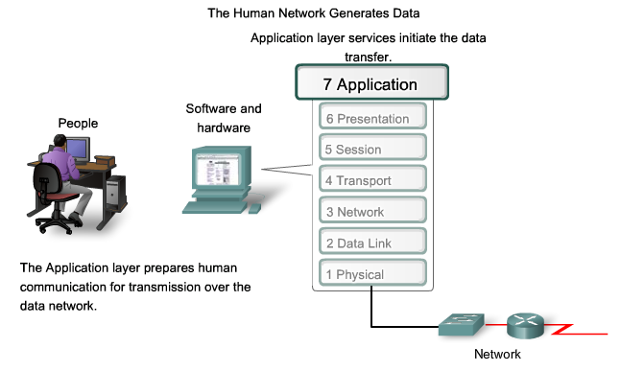
Applications –
The Interface Between Human and Data Networks
Explain the role of applications, services and protocols in converting communication to data that can be transferred across the data network

Slide 5
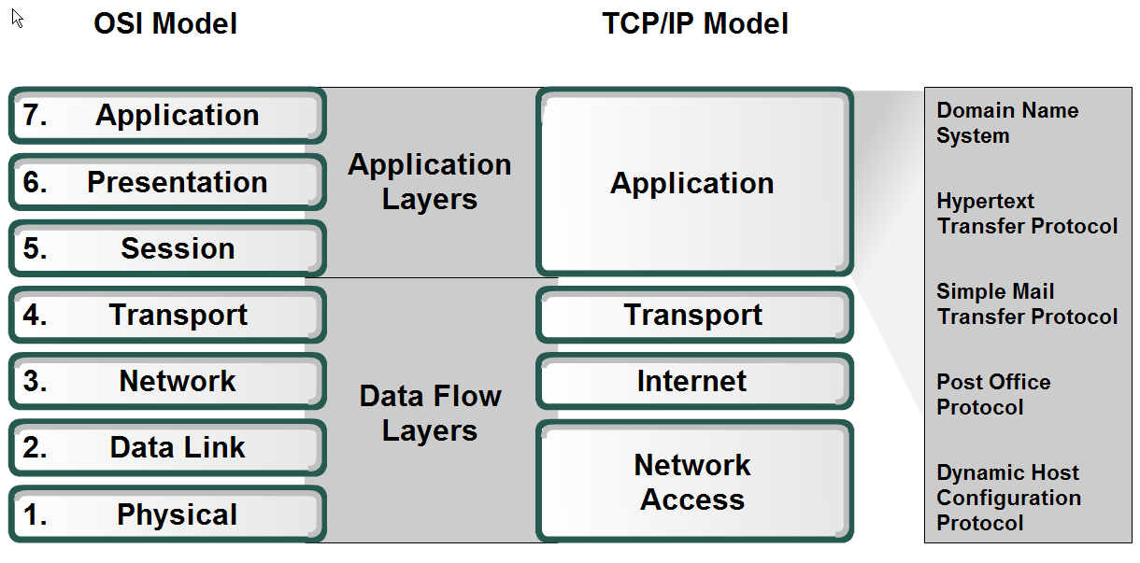
Applications –
The Interface Between Human and Data Networks
Define the separate roles applications, services and protocols play in transporting data through networks

Slide 6
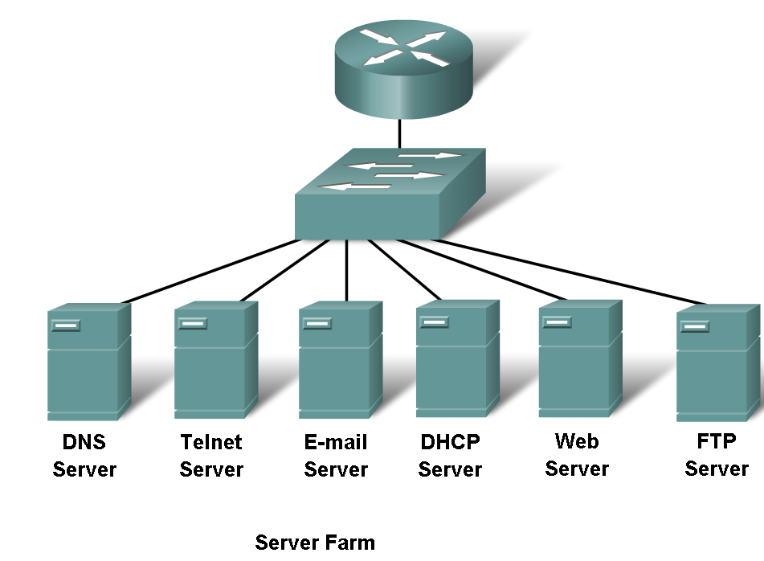
Applications –
The Interface Between Human and Data Networks
Describe the role protocols play in networking and be able to identify several message properties that can be defined by a protocol

Slide 7
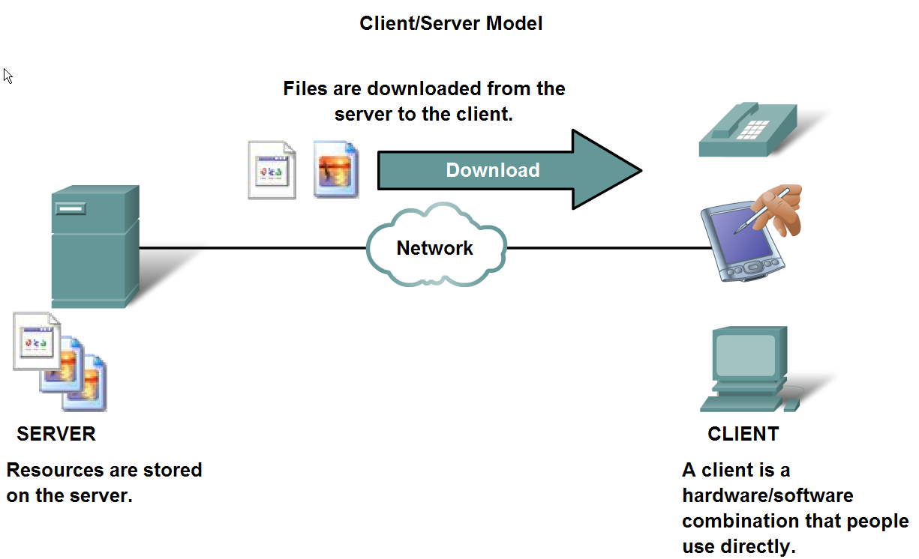
The Role of Protocols in Supporting Communication
Describe the roles of client and server processes in data networks

Slide 8
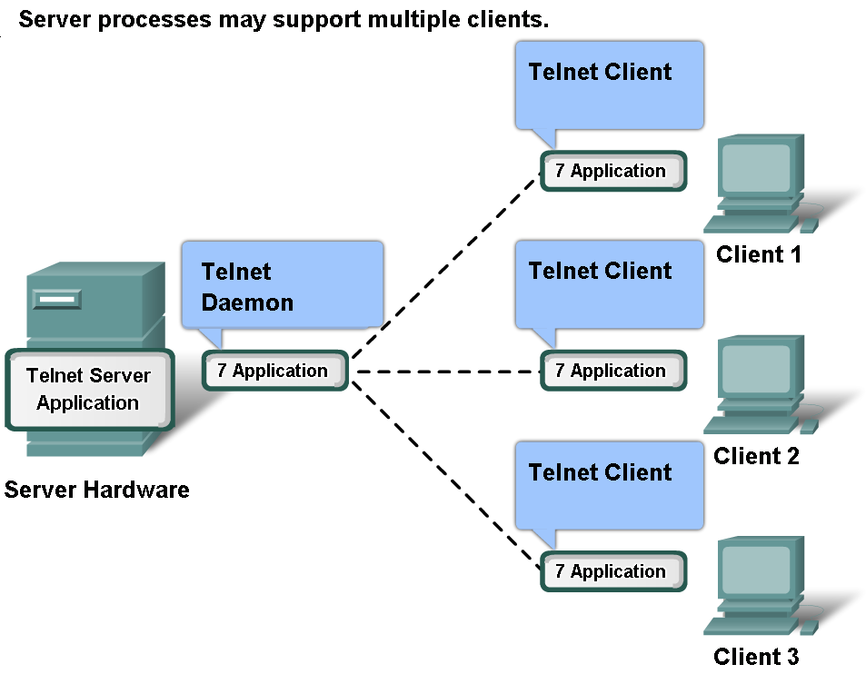
The Role of Protocols in Supporting Communication
List common Application Layers services and protocols

Slide 9
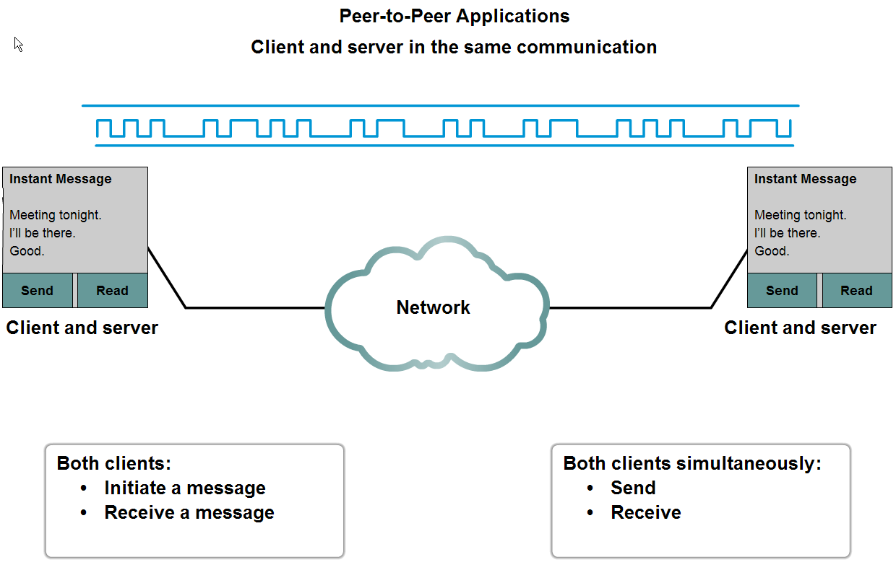
The Role of Protocols in Supporting Communication
Compare and contrast client server networking with peer-to-peer networking and peer-to-peer applications

Slide 10
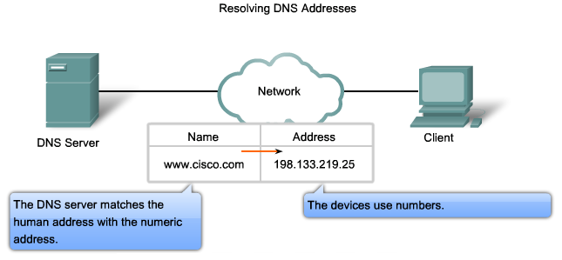
Features, Operation, and Use of TCP/IP Application Layer Services
Describe the features of the DNS protocol and how this protocol supports DNS services

Slide 11
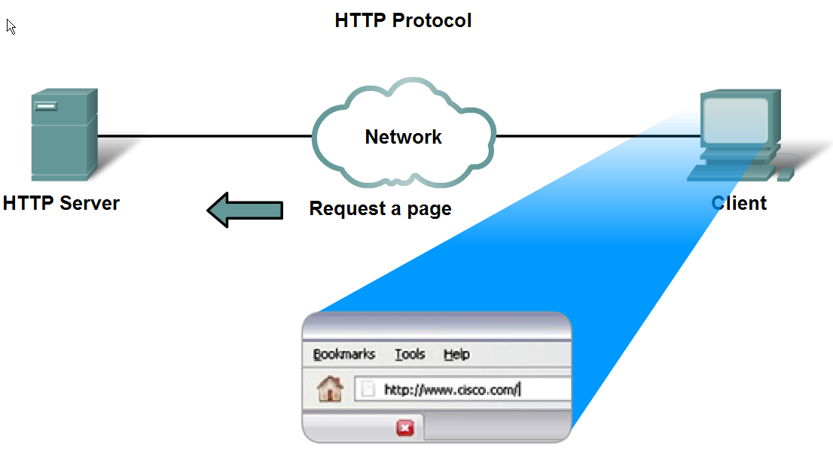
Features, Operation, and Use of TCP/IP Application Layer Services
Describe the features of the HTTP protocol and how this protocol supports the delivery of web pages to the client

Slide 12
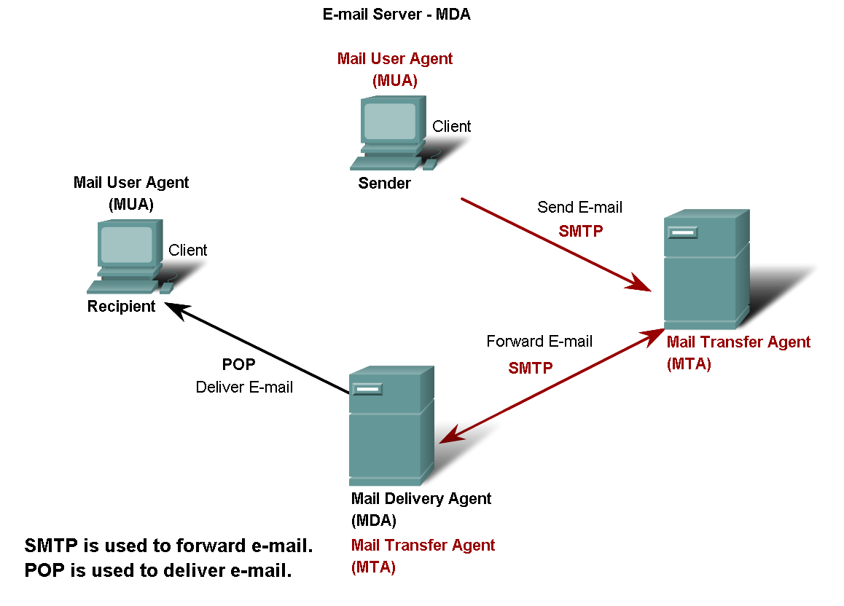
Features, Operation, and Use of TCP/IP Application Layer Services
Describe the features of the POP and SMTP protocols, and how these protocols support e-mail services

Slide 13
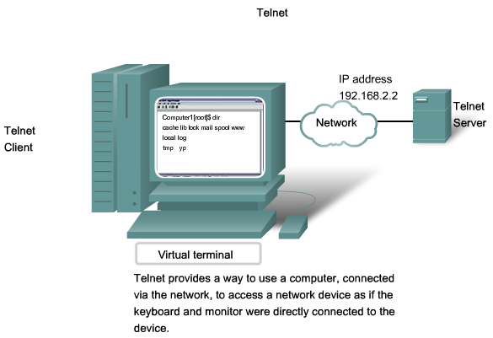
Features, Operation, and Use of TCP/IP Application Layer Services
Describe the features of the Telnet protocol and identify several of its uses in examining and managing networks

Slide 14
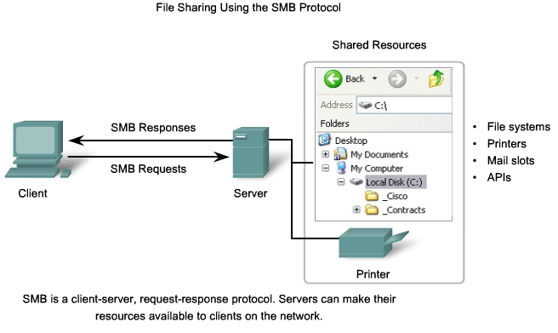
Features, Operation, and Use of TCP/IP Application Layer Services
Describe the features of the SMB protocol and the role it plays in supporting file sharing in Microsoft-based networks

Slide 15
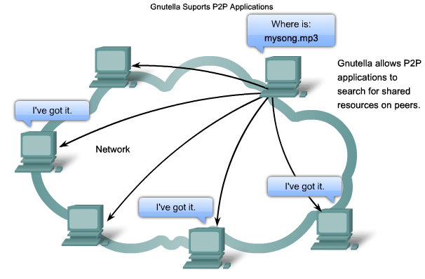
Features, Operation, and Use of TCP/IP Application Layer Services
Describe the features of the Gnutella protocol and the role it plays in supporting P2P services

Slide 16
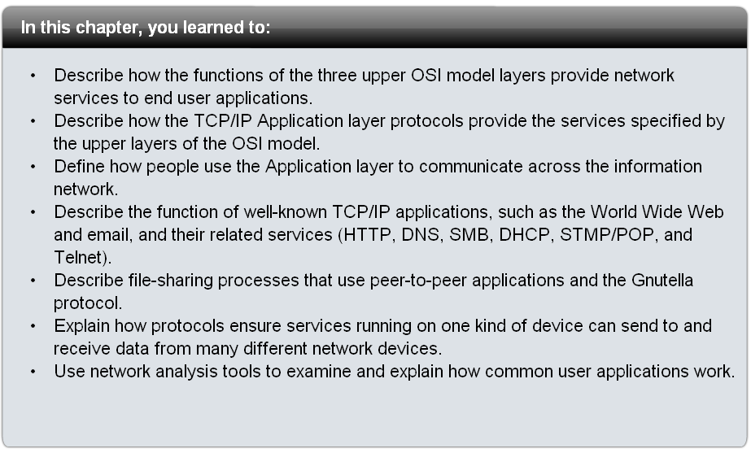
Summary

